Slide 1
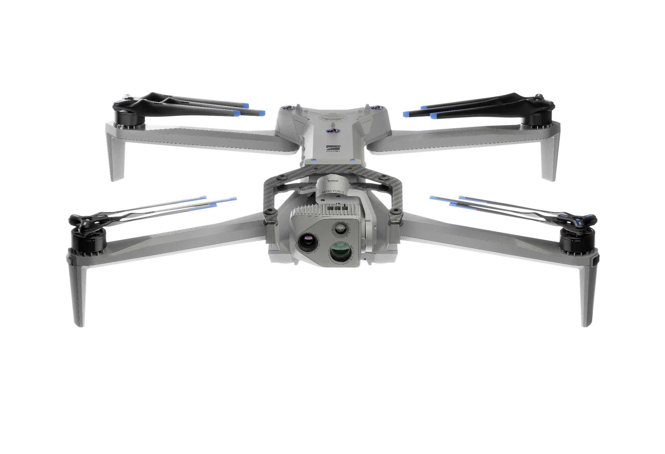

Course Overview
Skydio | R47-ATO-IP-deck1-4.3.26
Notes:
Trainer Notes: Good morning, team. Welcome to the Skydio X10D training course. Over the next two days, you’ll be immersed in the capabilities, safety procedures, mission planning, and real-world application of the Skydio X10D. This system was purpose-built with the warfighter in mind, integrating autonomy, ISR capabilities, and ruggedness into a powerful tactical UAS.
Why are we here? The modern battlefield demands instant intelligence, reduced manpower risk, and systems that can operate in any environment; urban, jungle, desert, GPS-denied. The Skydio X10D isn’t just a drone… It’s a tactical edge.
You’re not learning how to fly a toy. You’re learning how to deploy an autonomous ISR platform that can get you eyes on target faster, safer, and smarter than ever before. This training will ensure you can integrate that asset confidently into your mission set.

Slide 2
Introductions
Course Overview
01
Notes:
Trainer Notes: Let’s begin with introductions. We’re creating a shared learning environment here. Peer knowledge will strengthen the experience.
Share your…
Name
Your role
Prior UAS or ISR experience
What are you looking forward to in this course?
What will you be using this system for?
I’ll start… [Trainer intros themselves]

Slide 3
Course
Overview
Skydio X10D Course Overview
02
Notes:
Trainer Notes: This is a hands-on, instructor-led course. By the end, you’ll be able to safely operate the Skydio X10D, plan and execute autonomous missions, perform maintenance and troubleshooting, and understand how this system can serve as a force multiplier in ISR and battlefield awareness.

Slide 4
Course Overview | Training Overview
Course Overview
This hands-on instructor-led training will equip you with a deep understanding of the Skydio X10D systems and capabilities, enabling you to execute safe and effective flight operations, utilize autonomous flight modes and mission planning, and apply your skills in real-world missions with confidence and precision.
Notes:
Trainer Notes: The Skydio X10D is not your average drone. It’s a multi-sensor autonomous platform that removes the complexity of flight so you can focus on the mission. We’ll guide you through not only how to fly it, but how to maximize its capabilities, like thermal imaging, GPS-denied navigation, AI-driven obstacle avoidance, and more.

Slide 5
Course Overview | Course Objectives
Course Overview
Identify the components of the Skydio X10D system
Safely launch, fly, and recover the Skydio X10D system
Use onboard sensors to effectively exploit targets
Plan and execute automated missions
Perform field-level maintenance on the Skydio X10D system
Perform troubleshooting measures on the Skydio X10D system
Notes:
Trainer Notes: By the end of this course, you will be able to
Identify every component in your Skydio kit
Conduct safe takeoffs, flights, and recoveries in different environmental conditions
Use Skydio’s onboard autonomy to plan and execute missions with precision
Conduct basic maintenance and troubleshoot issues in the field
These are combat-critical skills… Not just tech skills

Slide 6
Course Overview | Expectations
Course Overview
Maintain SAFETY at all times
Must attend and participate in all 5 classroom modules
Must complete 4 flights at a minimum
Ask questions
2-way learning environment
Notes:
Trainer Notes: A few ground rules
Safety is mission-critical. Always follow my instruction, especially during the flight training.
This is an interactive environment. You’re expected to participate in all classroom and flight modules.
You’ll need to complete a minimum of four flights.
Ask questions, challenge concepts. This is a two-way environment. You bring operational knowledge and we’ll bring the platform expertise.

Slide 7
Course Overview | Schedule
Course Overview
Day 1 | Learn the Fundamentals
Day 2 | Apply the Fundamentals
Learn about the X10D and its functions. Learn to preflight your equipment, fly, and build missions.
Detailed description of X10D systems
Safely prepare the X10D for flight
Preparing additional resources
Apply what you have learned in comprehensive scenario based live flights.
Scenario-driven drone flights
Highlight Skydio X10D features and skills
Develop safe flight practices
Notes:
Trainer Notes:
Day 1: We'll begin with platform familiarization. Hardware, sensors, the X10D system, flight safety, and how to use the Skydio Controller. You’ll practice building missions and prepping the aircraft.
Day 2: We'll transition into live scenarios. These are tactical ISR (Intelligence, Surveillance, and Reconnaissance) flights built around realistic conditions. You’ll apply what you’ve learned. Like, running recon, perimeter overwatch, or target tracking. You’ll see how Skydio adapts to terrain, dynamic obstacles, and GPS-denied environments."

Slide 8
Questions
Course Overview
Notes:
Trainer Notes: Before we begin, do you have any questions? Remember, this is your course. The more you engage, the more you walk away with…. [wait for questions] Let’s get into it.

Slide 9

Use or disclosure of data contained on this sheet is subject to the restriction on the second page of this proposal

